Slide 1
Deep Learning Final Project
Roy Madpis & Michael Kobaivanov

Slide 2
THE AGENDA
Introduction
01
EDA
02
Modeling
03
The Research question
Displaying the modeling approach, model archtecture, performance
CONCLUSIONS
04
Recommendations & Action Items
Displaying charts and initial analysis of the data

Slide 3
01
Introduction

Slide 4
Introduction
01
Searching for parking spaces on the street causes a significant part of the urban traffic and results in extra costs for the drivers in terms of time and fuel consumption.
We want to create a model that could save drivers a lot of time by providing them the streets with higher probability to find a parking spot in a given time frame.

Slide 5
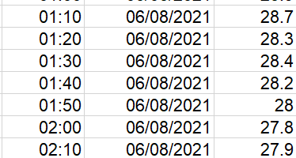
The Data
01
Over 200K documented parking clearances in over 50 streets
10-min interval temperature data
We decided to focus on 3 streets with major amount of parking clearances events (with 56K parking clearances)

Slide 6
The Research Question
01
For each future 5 minutes interval
(for the next 30 minutes)
Predict whether there would be an available parking spot in a given street?
Notes:
להסביר פה את הנקודה שבחרנו אינטרוול של 5 דקות כדי לאפשר לנהג מספיק זמן להגיע לרחוב מרגע קבלת הפרדיקציה

Slide 7
02
EDA
Exploratory Data Analysis for the data we have

Slide 8
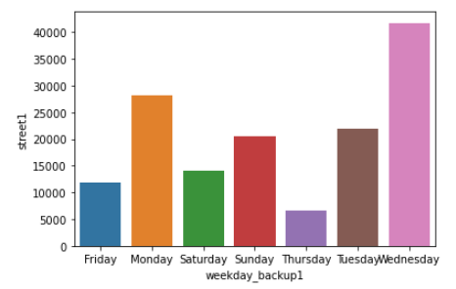
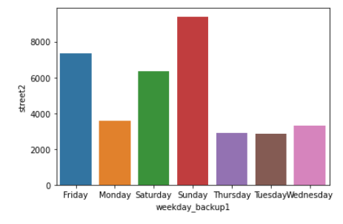
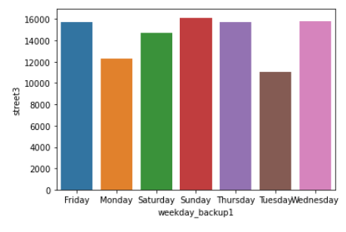
Parking clearness cases by weekday
02
Street 1
Street 2
Street 3
Each street has different parking clearness distribution
by weekday – need to build a model for each street

Slide 9
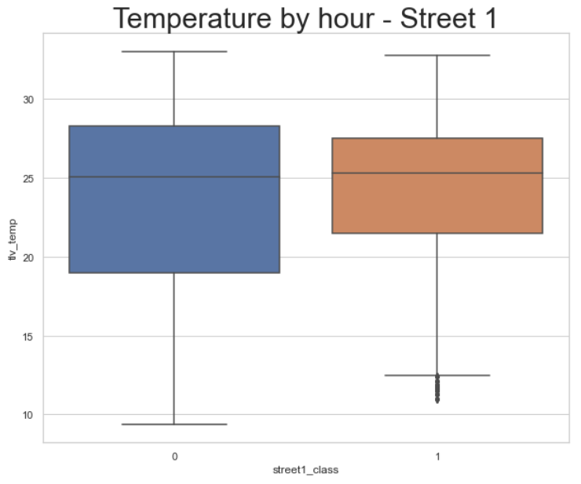
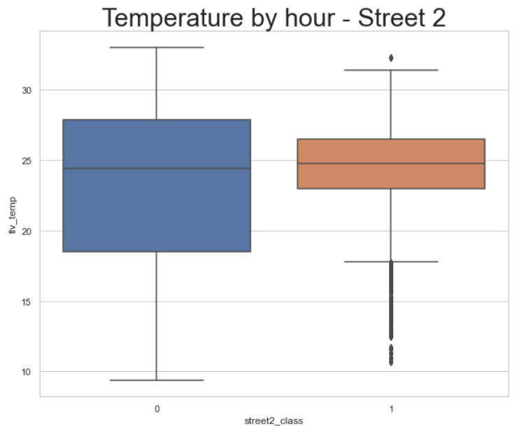
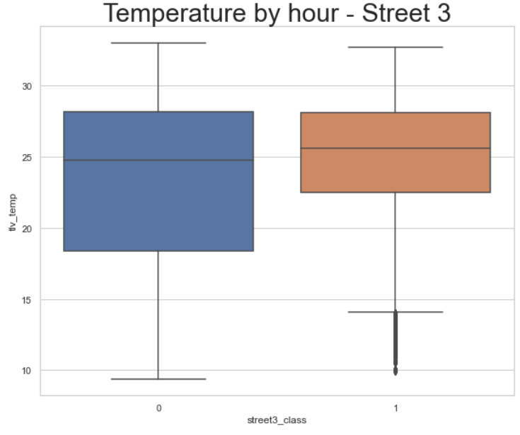
Parking clearness cases vs Temperature
02
Street 1
Street 2
Street 3
0 = There isn’t an available parking spot
1 = There is an available parking spot
It is more likely to get a free parking spot with Higher temp

Slide 10
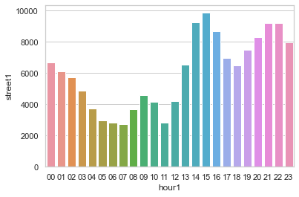
Parking clearness cases vs time graph – street 1
02
In street 1 - Most of the parking clearness cases occur between 14:00 – 22:00

Slide 11
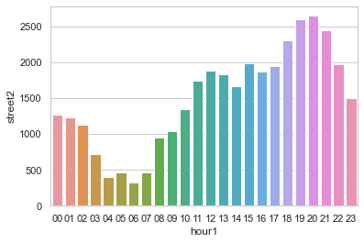
Parking clearness cases vs time graph – street 2
02
In street 1 - Most of the parking clearness cases occur between 17:00 – 21:00

Slide 12
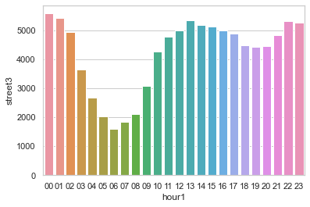
Parking clearness cases vs time graph – street 3
02
In street 1 - Most of the parking clearness cases occur between 11:00 – 01:00

Slide 13
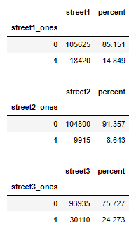
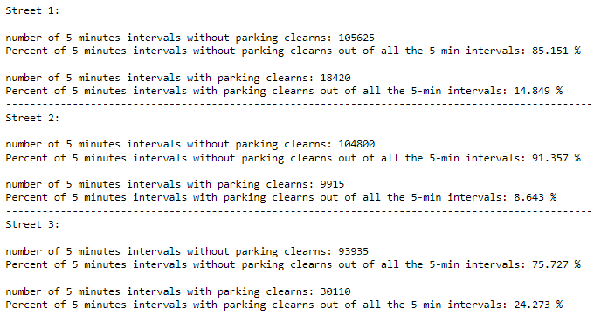
5 min intervals with parking clearness out of the total 5 min intervals for each street
02

Slide 14
We saw different behavior for each street → we need to build a model for each street
02

Slide 15
03
Modeling
Modeling approach + performance on train + test sets

Slide 16
Modeling approach
03
Step 1: build a Neural Net regression model that predicts, for each 5 minutes interval “how many available parking spaces” there would be.
Step 2: Transform the output into a binary classification:
If the score, given by the regression model, is higher than a given threshold – the class will be 1 (predicting there would be an available parking spot in the 5 min interval), else 0.
Notes:
שלב 1: בניית מודל שחוזה, עבור כל אינטרוול של 5 דקות, כמה חניות פנויות יהיו. באופן הזה מרגע ביצוע החיזוי אנו מקנים מספיק זמן לנהג להגיע למקום שבו בפוטנציאל תתפנה חניה

Slide 17
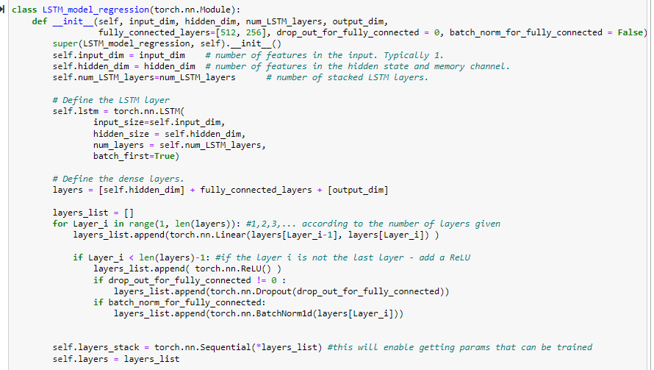
03
Step 1 – Regression model
We used a Timeseries analysis method thus built a neural net model that uses an LSTM (Long Shoer-Term Memory) model.
The structure that was used:
Notes:
לפרט פה על כמות ה-layers, מה הגודל שלהם וכו'
לציין גם את הניסיונות הנוספים שביצענו!

Slide 18
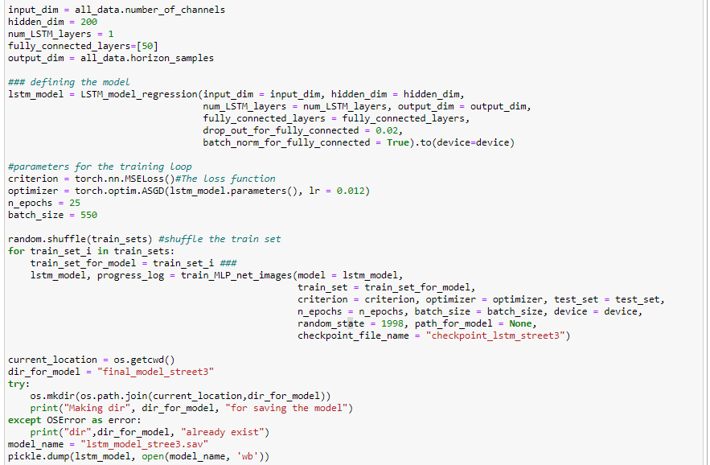
Parameters that define the LSTM model + the fully connected layers
Parameters for the training loop
We had to split the train set into 10 sub sets and retrain the model 10 time
The checkpoint enables to retrain the model with future given data
Saving the final trained model

Slide 19
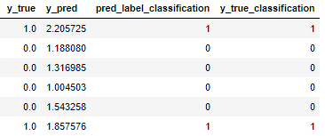
03
Step 2 – Classification model
We converted the y_true and y_pred labels into 0 and 1 (if the value of y_true | y_pred was higher than a given threshold, the new value was 1, else 0)

Slide 20
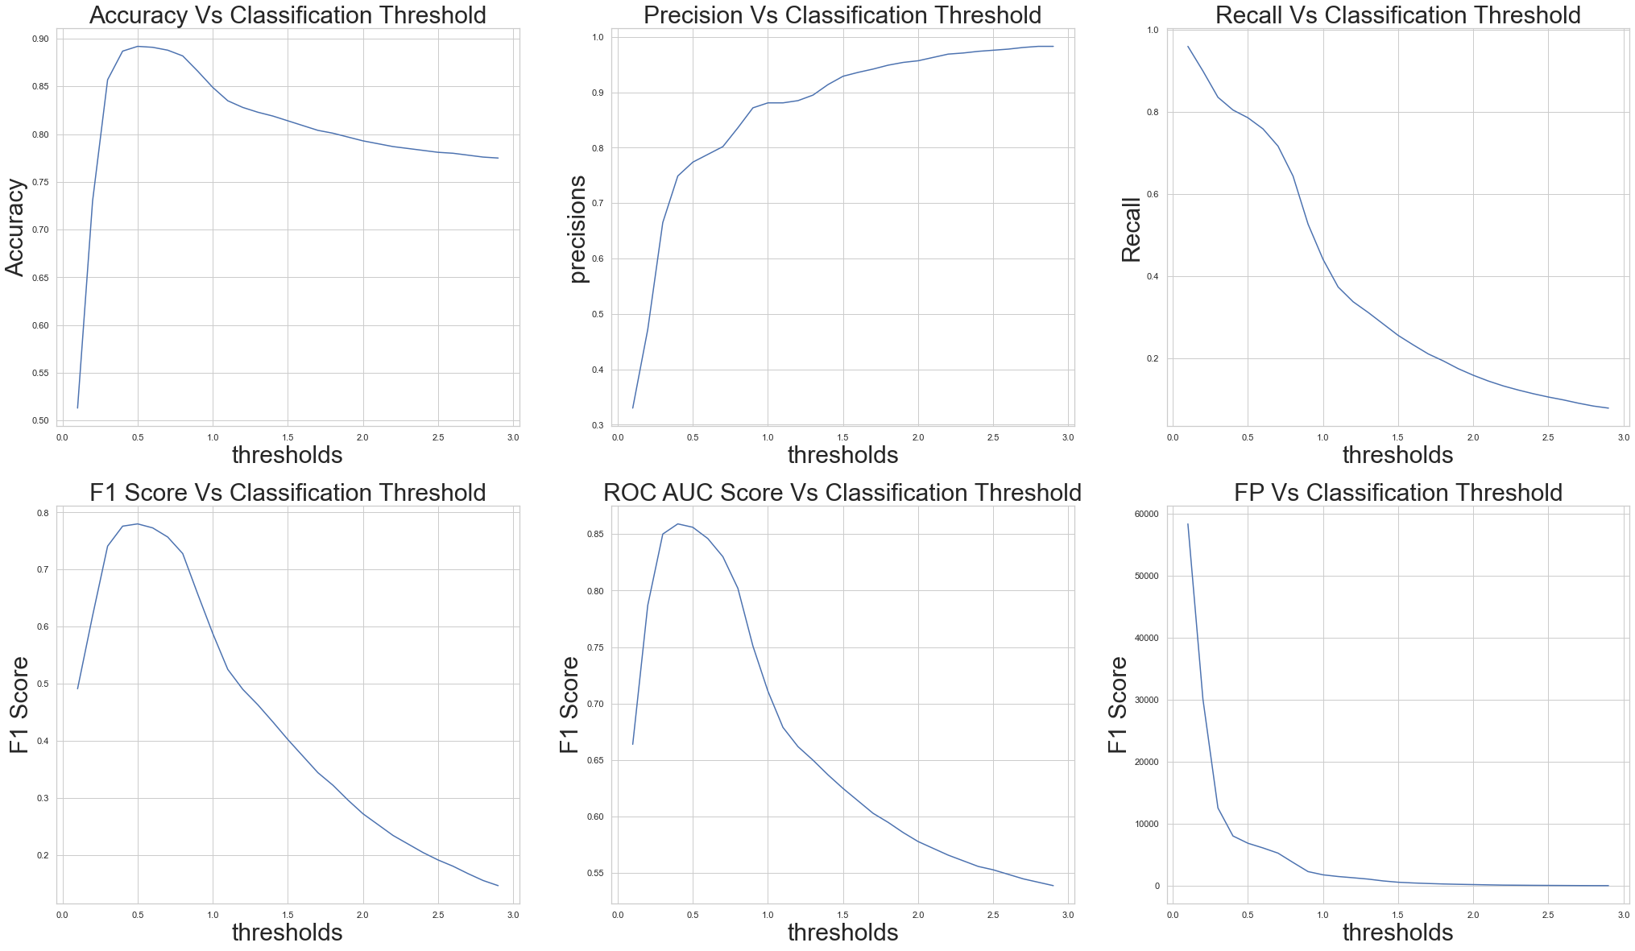
Model Performance on Train Data
03
In all countries similar expenses distribution
*In Australia – 80% compensation ($27.7M)
*In India – 18% Financial&Professional ($1.82M)

Slide 21
The highest AUC score was gained with: For street 1 → threshold = 0.21 For street 2 → threshold = 0.2 For street 3 → threshold = 1.2
02

Slide 22

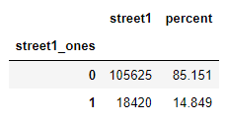
For Street 1: The highest AUC score was gained with: threshold = 0.21
02
Reminding the base rate of the population

Slide 23

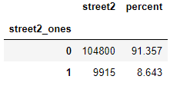
For Street 2: The highest AUC score was gained with: threshold = 0.2
02
Reminding the base rate of the population

Slide 24

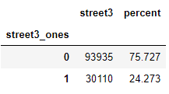
For Street 3: The highest AUC score was gained with: threshold = 1.2
02
Reminding the base rate of the population

Slide 25
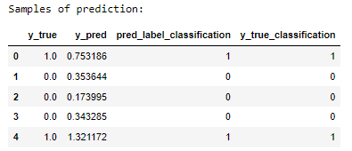
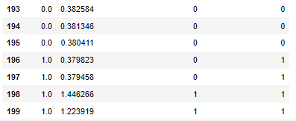
Performance on Test Data - Samples of prediction:
Street 3
03

Slide 26
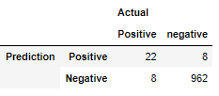

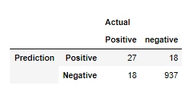

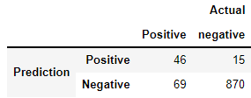

Total Performance On Test Set
03
Street 1
Street 2
Street 3

Slide 27

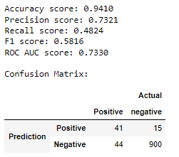
Performance on Test Data with threshold = 0.4
Street 3
03
Samples of prediction:
Total Performance On Test Set

Slide 28
04
Conclusions
Main Conclusions and Key Takeaways & Recommendations

Slide 29
Key Takeaways & Conclusion
The EDA shows that weekday, time of the day and temperature have an impact on the prediction
Different Street have different parking clearness typical behavior thus need to build a model for each street alone
There is a tradeoff between precision and recall, therefore even though we want to maximize the precision, we must also consider the recall (and accuracy). We decided using the AUC score instead.
Each one on the 3 models had a different threshold that yielded the highest AUC score

Slide 30
THANK YOU

